Slide 1

A Presentation on
Industrial Training
Submitted by Submitted to Ashish Chauhan Prof. Rakesh Galav
Notes:
A Industrial Training Report Submission as an College final year project .

Slide 2
What we are covering with this Presentation ?
Company Details
Project Details
Software Development Process Model
Project Tech Stack
Acknowledgement
Conclusion
Project Main Modules

Slide 3

Company Details
SCS (Shrestha Consultancy Services Pvt. Ltd.) is one of the Mathura based leading Information Technology Service and Solutions provider Company with highly experienced team which started in 2015.
SCS helps customers do business better by leveraging our industry-wide experience, deep technology expertise, comprehensive portfolio of services and vertically aligned business model. This organization provide world-class cost-effective solution for your business which deals mainly in BPO Services, Applications Services, Consulting Services, Web Development Services, Website Designing Services, SEO Services, Domain Services etc.
Notes:
This is a Mathura based IT company usually deals in IT services .

Slide 4

Project Motivation
The biggest motivation to create This software is the recent incident that happened with me while I was in a hospital, The hospital process was complete chaos there are long waiting queues in almost every department either that is Medicine, Reception, Payment, Doctors Availability, etc.

Slide 5
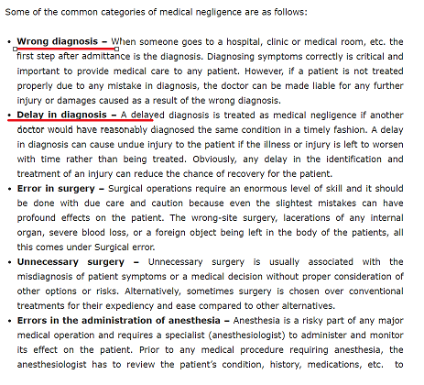
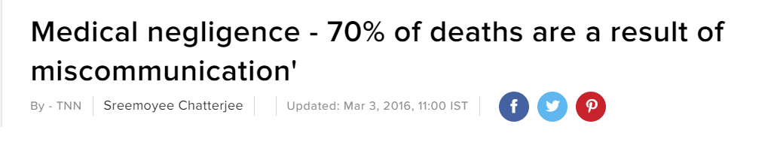
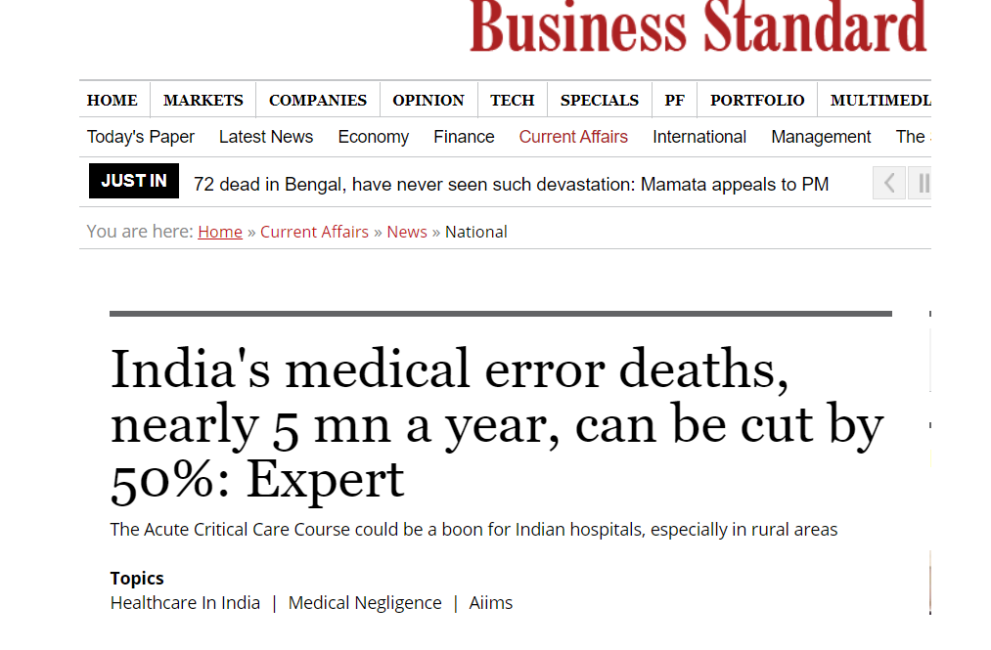
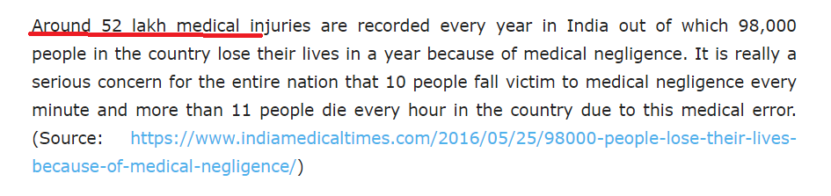
A Study
Notes:
A Report has been published in Times of India and other prime news paper of India .
As we can see this data is very alarming, we can develop solution to handle few of the cases .
https://timesofindia.indiatimes.com/life-style/health-fitness/health-news/Medical-negligence-70-of-deaths-are-a-result-of-miscommunication/articleshow/51235466.cms
https://www.business-standard.com/article/current-affairs/india-s-medical-error-deaths-nearly-5-mn-a-year-can-be-cut-by-50-expert-118102800193_1.html

Slide 6

Medi-pulse Overview
Medi-pulse Software is the primary solution to speed up the medical services in India. Which works mainly in the direction to reduce day to day workload on medical staff so they can focus more on things. which require more attention i.e. patients
Medi-pulse software will help medical staff to be better in error-prone areas. From the patient's point of view, this software will make their life easier as they do not have to possess files, medical records all the time with them. This software has modules according to hospital departments.
This software is divided in 7 Major Modules.
Notes:
Medi pulse is a Window Based Application which is built by keeping in mind all the problems that a hospital faces on daily basis
We started this project in Feb. of 2020 and build some key functionalities because it have vast scope and we have very limited time , so we prepared a roadmap to add more feature in the upcoming Releases .

Slide 7
SDLC
Requirement Analysis
Design
Development
Testing
Deployment and maintenance
Notes:
We spent a lot of time over deciding what and how we should move forward in development process , so we followed Agile for our SDLC

Slide 8
Technology Stack
Technology : .net Framework 4.5 to support windows platform.
Database : SQL Server 2008 R2 for all RDBMS.
Language : Application codebase is written in C#. And for Reporting purpose we use RDLC report.
Software : Visual Studio 2012 Community Edition, SQL Server Management studio 18, FxCop as Static Code Analyzer, JMETER for load Testing
Version Control: Git

Slide 9
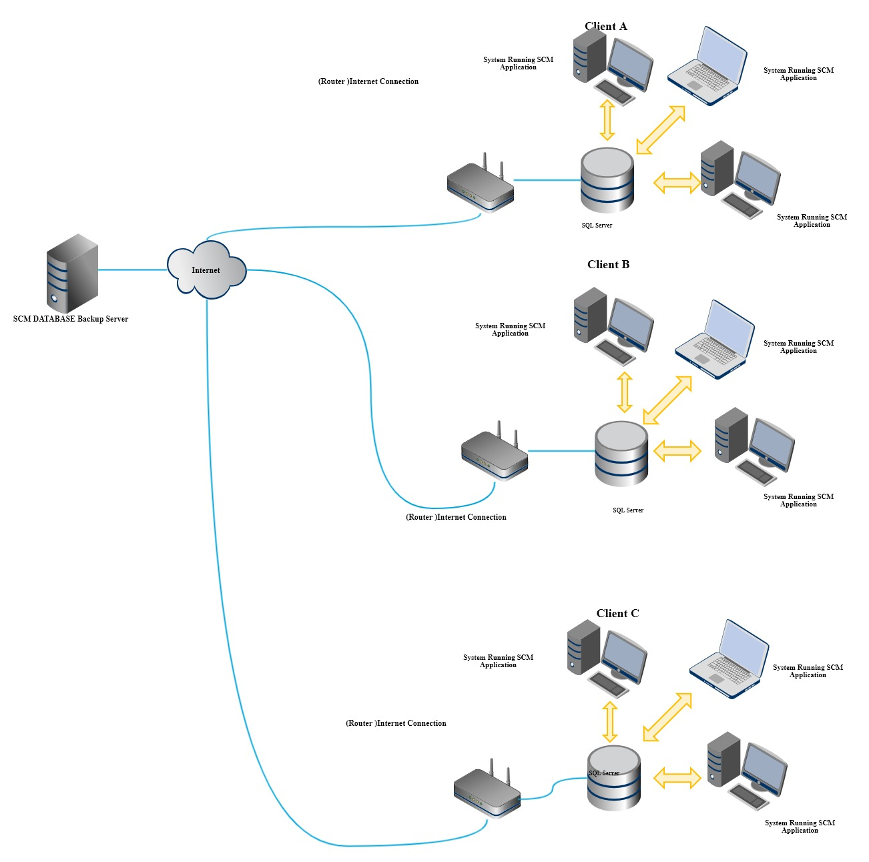
Application Architecture

Slide 10
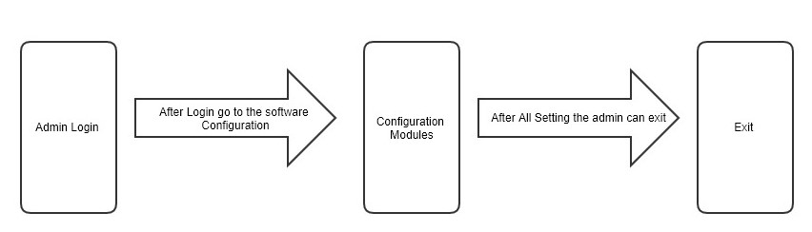
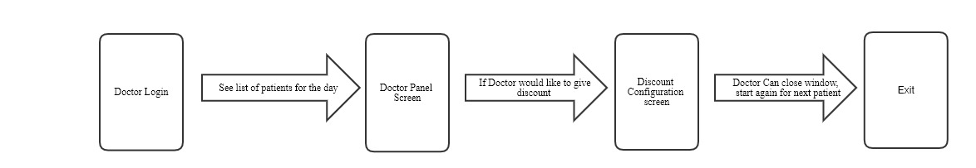
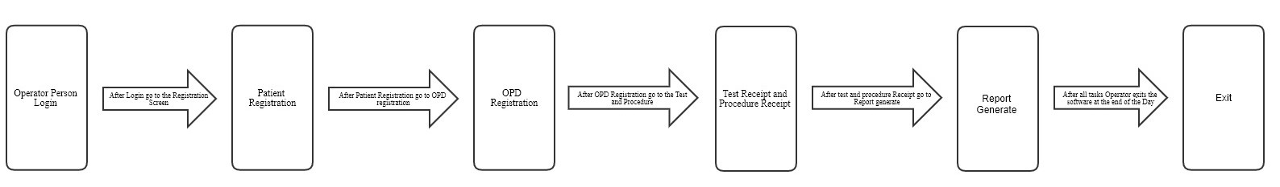
Implemented User Flows A) Admin Flow B) Doctor Flow C) Staff Flow
Notes:
Implemented User flows Conclude the Generalised Requirement that we have gathered from multiple Hospital clients , so we have decided to implement these workflows in our software 1st release .

Slide 11
Modules
Master Module
Registration
Queue Process
Reports
Configuration Module
Settings
Accounting

Slide 12
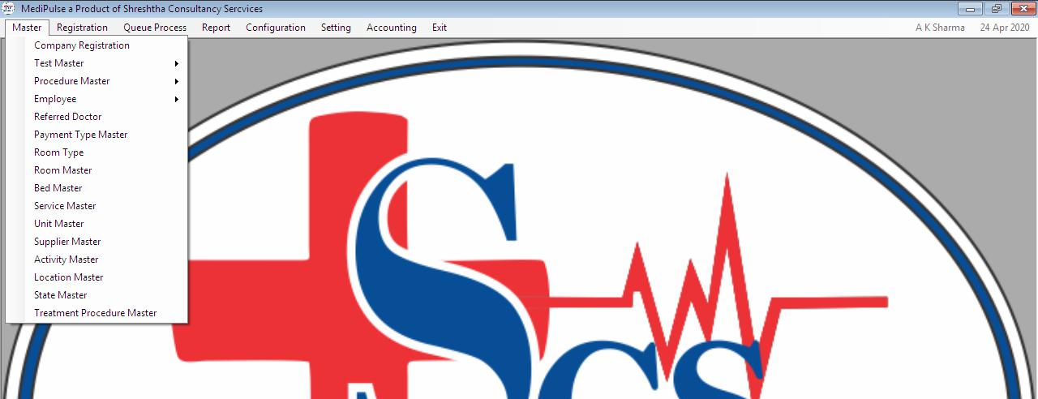
Details of Modules
Masters: Master module is used to configure the software according to hospital , Most of them are one time configuration.
Registration: Used for Registration of new Patient or OPD patient
Queue Process: Module to maintain patient queue, each doctor can see his list of patient enrolled for a day as well as we can display information of upcoming patient on an external display.
Reports: Module used to display multiple reports required by hospital, Reports are generated in PDF which can be printed
Notes:
Master Module -- This module is used to Configure the software according to Hospital. This module is divided in many other sub modules that are being used for configuration of the software for that Hospital. This master module is containing the sub modules of Employee , Test Master , Room type, Room master , Bed Master , Service master. As in Employee master the Operator person of hospital can add the Employee to the Software. As any new employee join the hospital then the operator person can add that employee and configure that employee into the system.
Registration Module - This module is used to do the registration of the OPD Patients or IPD patients. In this menu the registration is done. As new patient in OPD or IPD is appered , then to keep the record of that patient in the hospital , this menu is used.
Queue Process - This module is used to maintain the queue of patients outside of the doctor cabin. and to show the list of patients for a doctor in a day.
Reports Module - This menu is used to generate the reports in our software. This menu provide the utility to print the OPD collection of a period of time , or Test collection of a period of time. Using this menu the Operator person of hospital can print the different reports.

Slide 13
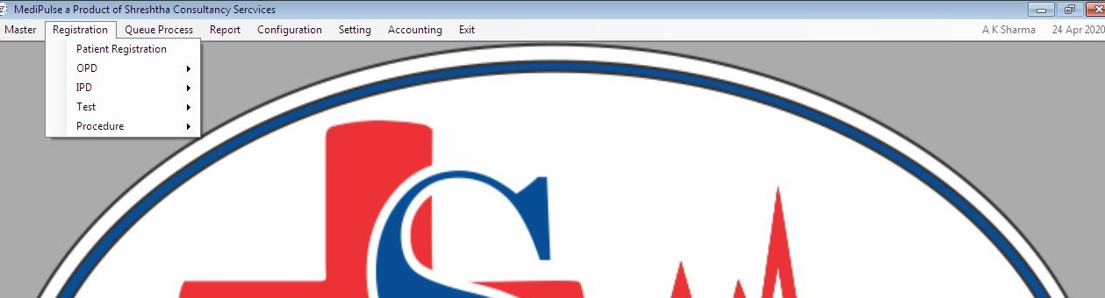
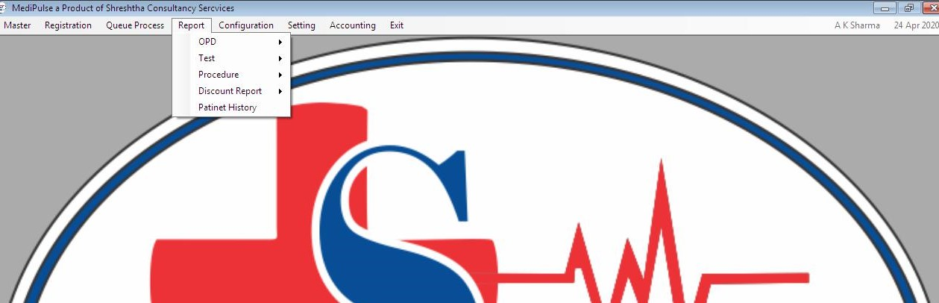
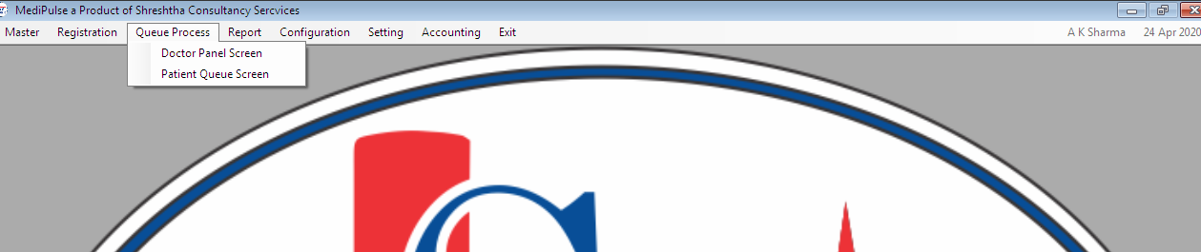
Notes:
Registration Submenu –
2.1. Patient Registration: Used to register the new patient in the Hospital.
2.2 OPD Registration: Used to register the OPD patient in the Hospital.
2.3 IPD Registration: Used to register the IPD patient in the Hospital.
2.4. Test Receipt: Used to generate the test receipt for the tests performed on a patient.
2.5. Procedure Receipt: Used to generate the procedure receipt for the procedure performed on a patient.
Reports Submenu –
4.6.1 OPD report – There is multiple reports regarding OPD which is listed below
4.6.2 Test Reports - There is multiple reports regarding Test Procedure Performed in hospital, Test reports can also be filtered same as OPD Report, Doctor wise, Operator Wise
4.6.3 Procedure Reports - There is multiple reports regarding Procedures Performed in hospital, Test reports can also be filtered same as OPD Report, Doctor wise, Operator Wise
4.6.4 Discount Report – This Report contains all the Discount given at various places so to list all of it we introduced 3 reports in this
4.6.5 Patient History – This is used to show the history of Patients in hospital in a span of time.

Slide 14
Details of Modules
Configuration Module: Configuration module is used to configuration in the software. This module is accessible to the Admin These configurations are mostly runtime configurations
Settings: Used by the admin of the software for activation, Database backup, reset password. This is only accessible by admin.
Accounting: Used for handling all money related process of the hospital
Notes:
Configure Module - Used to configure Hospital according to its Requirement, This module is divided in many other sub modules that are being used for configuration of the software for that Hospital. This master module is containing the sub modules of Employee , Test Master , Room type, Room master , Bed Master , Service master. As in Employee master the Operator person of hospital can add the Employee to the Software. As any new employee join the hospital then the operator person can add that employee and configure that employee into the system.
Setting module - This menu is used to setting the Licensing process of software. This menu provides the privilege to admin to backup database or other security.
Accounting module – Used to keep record of all hospital money transaction.

Slide 15
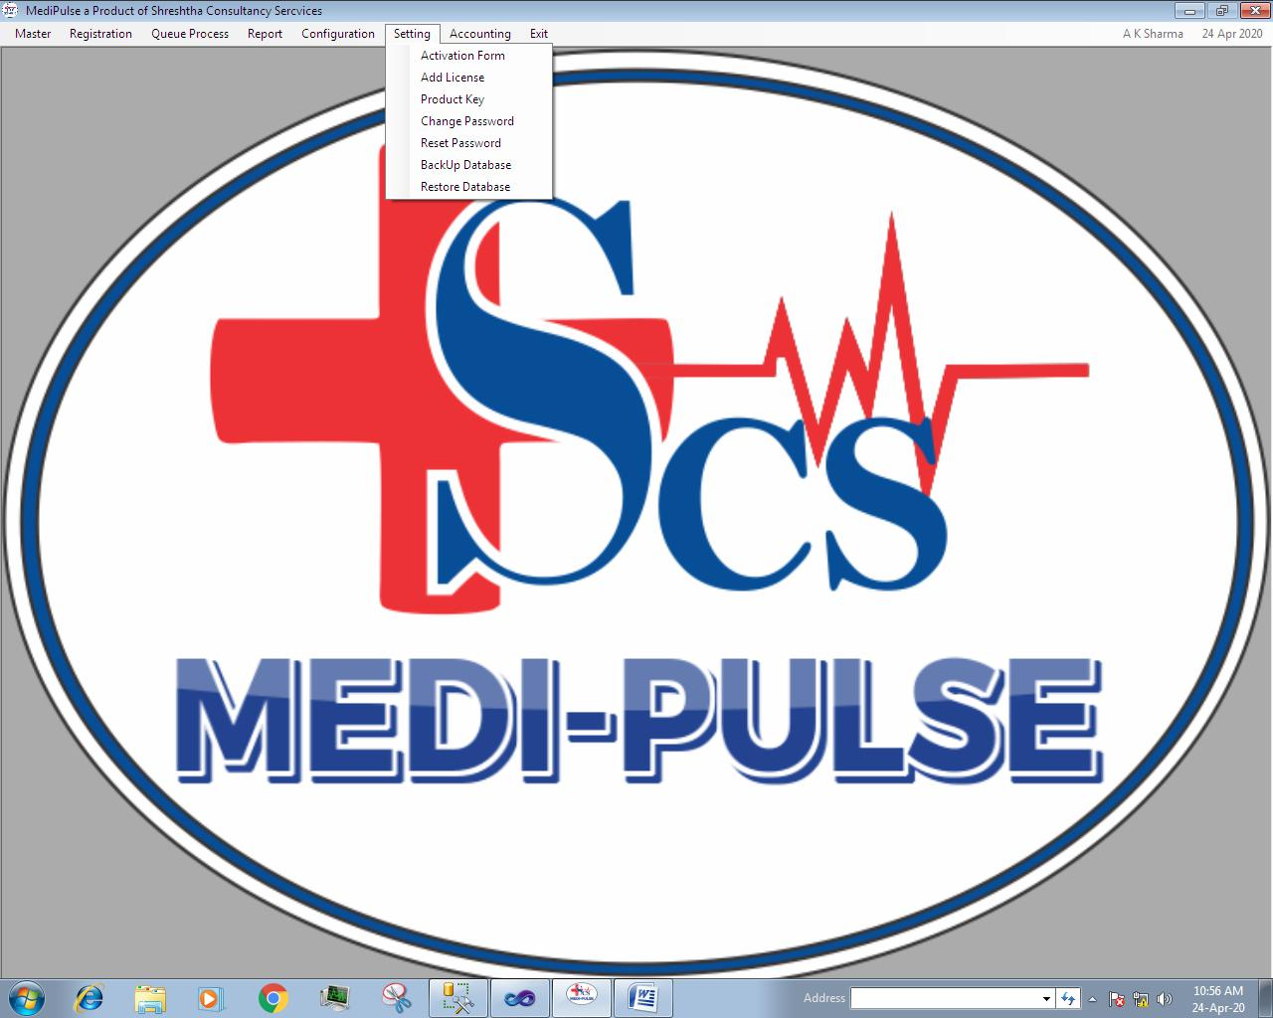
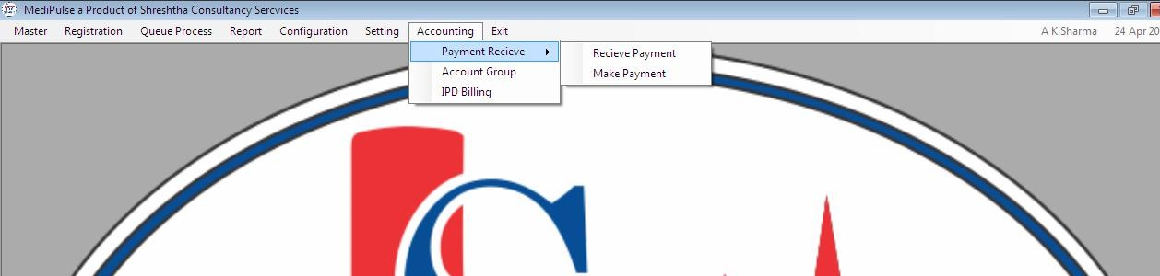
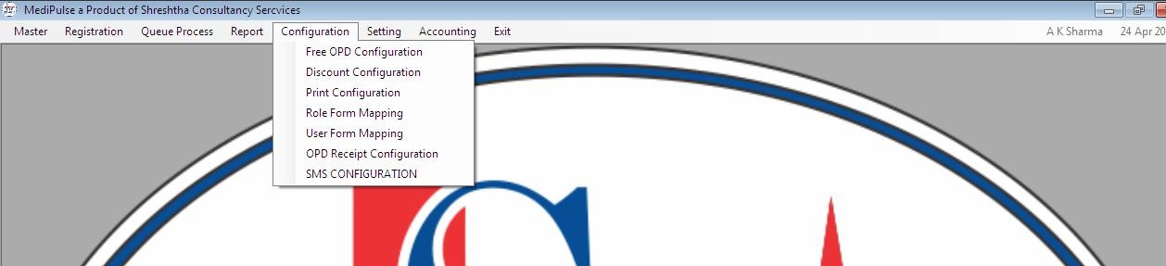

Slide 16
Conclusion
The objective of this application was to reduce the stress of Medical staff and help them to do their work more efficiently and make error prone process a sturdy accountable process and we are able to achieve it in some sense.
This project gives me a chance to learn a lot about coding patters, coding best practices, Handling large Transactional Database, code versioning Tools like GIT.

Slide 17
Acknowledgment
I would like to express my special thanks of gratitude to my college as well as our Project Coordinator Mr. Rakesh Galav who gave me the golden opportunity to do this wonderful industrial Training project , I would also like to extend my thanks to Mr. Rajiv Kulshrestha CEO of Shrestha Consultancy Services for Providing me a chance of internship in his Organization , which also helped me in doing a lot of Research and I came to know about so many new things I am really thankful to them.
Secondly, I would also like to thank my parents and friends who helped me a lot in finalizing this project within the limited time frame.

Slide 18


Questions ?

Slide 19

Thank You

